Slide 1


Aug 31 2020
Pangolin:
An Efficient and Flexible Graph Pattern Mining System on CPU and GPU
Confucius said, the accomplished scholar is not a utensil.
Xuhao Chen, Roshan Dathathri, Gurbinder Gill, Keshav Pingali
The University of Texas at Austin
Notes:
Hello everyone. My name is Xuhao Chen. I am from UT Austin.
Today I will present our work Pangolin, an efficient and Flexible Graph Mining (GPM) System on CPU and GPU.

Slide 2
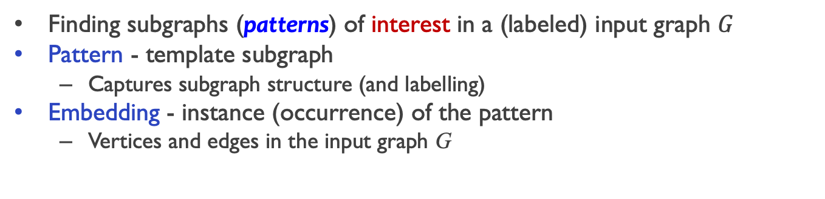
Graph Pattern Mining (GPM)
Finding subgraphs (patterns) of interest in a (labeled) input graph $G$
Pattern - template subgraph
Captures subgraph structure (and labelling)
Embedding - instance (occurrence) of the pattern
Vertices and edges in the input graph G
Support - measure of the frequency of pattern $P$ in graph $G$
Notes:
Graph Pattern Mining is to discover patterns of interest in a given input graph.
(click) A pattern is a template subgraph that is defined by the user. It captures the subgraph structure.
(click) these are the patterns need to be found in an application called motif counting, such as triangles and cliques.
(click) Another important term is the embedding.
An embedding is an occurrence of a pattern in the input graph.
It includes actual vertices and edges of the input graph.
In this example, the pattern is a triangle.
there are 2 embeddings of this pattern in this input graph.

Slide 3

State of the Art: Hand-written Solvers
 | Easy to Code | Transparent Parallelism | Optimization Flexibility | Efficient Implementation
Hand-written Solvers | ✗ | ✗ | ✓ | ✓
Triangle Counting (TC)
Clique Listing (CL)
Motif Counting (MC)
Frequent Subgraph Mining (FSM)
[1] TriCore: Parallel Triangle Counting on GPUs, SC, 2018
[2] Listing k-cliques in Sparse Real-World Graphs, WWW 2018
[3] Efficient Graphlet Counting for Large Networks. ICDM 2015
[4] A Distributed Approach for Graph Mining in Massive Networks, Data Min. Knowl. Discov., 2016
Notes:
To solve a GPM problem, one way is to implement a dedicated solver by hand.
(click) Here I list several GPM problems and their corresponding hand-written solvers.
hand-written solvers are time-consuming and error-prone to develop.
Also the programmer needs to deal with parallelism on modern parallel architectures,
which makes programming even more difficult.
The good thing is the programmer has the flexibility to control every detail of the mining process and apply all kinds of optimization techniques.
Hand-written solvers usually achieve high performance at the cost of lots of engineering effort.

Slide 4

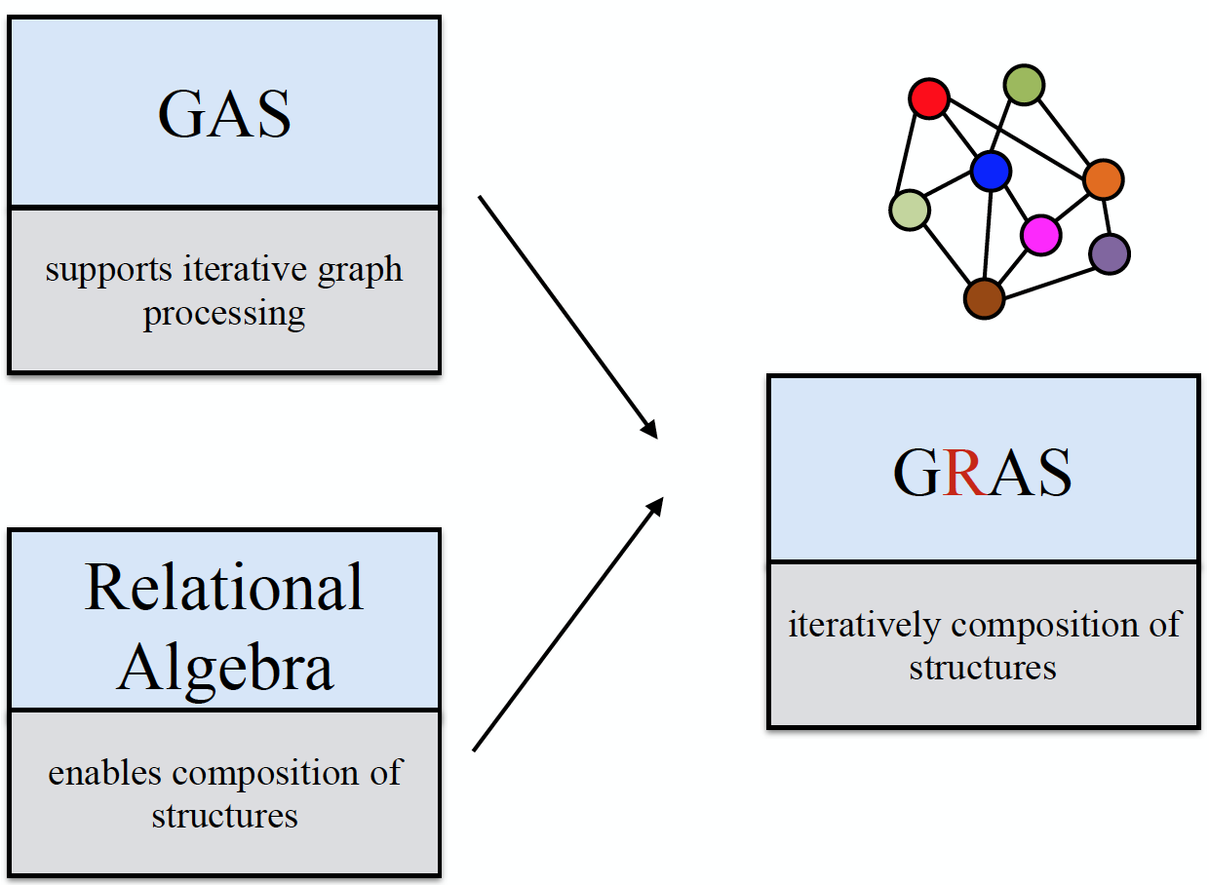
State of the Art: Existing GPM Systems
 | Easy to Code | Transparent Parallelism | Optimization Flexibility | Efficient Implementation
Hand-written Solvers | ✗ | ✗ | ✓ | ✓
Existing GPM Systems | ✓ | ✓ | ✗ | ✗
AutoMine SOSP’19
Fractal SIGMOD’19
Kaleido ICDE’20
Peregrine EuroSys’20
G-Miner EuroSys’18
Arabesque
SOSP’15
RStream
OSDI’18
Notes:
To improve programmability, many GPM systems have been proposed.
(click) Here I list some representative GPM systems.
They implement common functionalities for different problems and provide simple interfaces to the programmer.
Meanwhile the systems take care of the parallelism and the user only needs to write operators for each embedding in a sequential way.
The user program is then transparently parallelized on the targeted platform.
However, as I will show later, existing systems are not efficient. Many of these systems are orders-of-magnitude slower than hand-optimized solvers.

Slide 5
Pangolin: efficient & flexible GPM system
 | Easy to Code | Transparent Parallelism | Optimization Flexibility | Efficient Implementation
Hand-written Solvers | ✗ | ✗ | ✓ | ✓
Existing GPM Systems | ✓ | ✓ | ✗ | ✗
Pangolin | ✓ | ✓ | ✓ | ✓
Notes:
Motivated by this, we propose Pangolin an Efficient & flexible GPM Framework.
It is easy-to-ode and transparently parallelized on CPU and GPU.
It provides flexibility to the users to compose their own optimizations.
It is also highly efficiently implemented on both architectures.
includes a series of architecture-oriented optimizations

Slide 6
Limitations of Existing Systems
Application-specific optimizations are missing
Search space pruning
Avoiding graph isomorphism (GI) test
Inefficient implementation of parallel operations and data structures
Data Structures for Embedding List
Materialization of Data Structures
Dynamic Memory Allocation
Notes:
As I already mentioned, existing systems are not efficient. This is due to
First, many application-specific optimizations are missing in these systems.
such as search space pruning and avoiding graph isomorphism (GI) test.
Second, in these systems, parallel operations and data structures are inefficiently implemented on today’s parallel hardware.
Due to limited time I will only talk about the first part in this talk and you can find details about the second part in the paper.

Slide 7
Pangolin Contributions
Simple & flexible API to enable application-specific optimizations
Transparently parallelized on CPU and GPU
The first GPM system to support GPU mining
Efficient parallel implementation to exploit underlying hardware
Orders of magnitude speedup over existing GPM systems
Notes:
Pangolin overcomes these limitations.
It provides a Simple & flexible programming interface to enable application-specific optimizations
The interface keeps the simplicity as previous systems do, and exposes more flexibilities to the user to apply optimizations.
(click) Pangolin applications are automatically parallelized to exploit underlying hardware such as multicore CPUs and GPUs.
Pangolin is the first GPM framework that supports GPU mining.
(click) Parallel operations and data structures are efficiently implemented for the targeted architectures.
(click) Overall our system achieves orders of magnitude speedup over existing GPM systems.

Slide 8
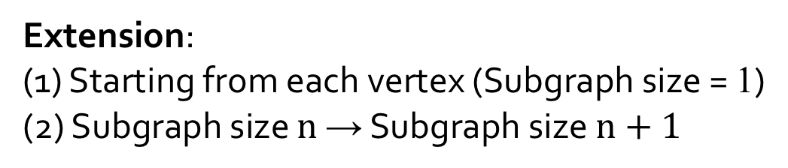
GPM Algorithm: extend-reduce
Extension:
(1) Starting from each vertex (Subgraph size = 1)
(2) Subgraph size $n$ → Subgraph size $n+1$
Notes:
To solve a GPM problem, Pangolin uses a simple execution model called extend-reduce.
Here I use an example of counting triangles.
Starting from each vertex of the input graph, 1, 2, 3, 4,
we iteratively extend one more vertex at a time until the pattern size is reached
v1, v2, v3, v4, (these are the single-vertex embeddings, or initial embeddings)

Slide 9
GPM Algorithm: extend-reduce
2-vertex embeddings
Notes:
So in the next iteration, we get all the 2-vertex embeddings.
We can notice that there are some redundant embeddings.
(click) For example, these two embeddings, 1-2 and 2-1.
We call them automorphisms. Since they are identical, we only need to keep one of them and discard the rest.
We use an automorphism check to pick a canonical one out of all its automorphisms.

Slide 10
GPM Algorithm: extend-reduce
Reduction:
Check each leaf, if it is a triangle, count += 1
Notes:
When the size of embeddings are the same as the size of the pattern (triangle),
It comes to the reduction stage. We check each leaf embedding, and if it is a triangle, we increase the total triangle count.
In general, to identify if an embedding is isomorphic to a specific pattern, we need to perform an isomorphism test.

Slide 11
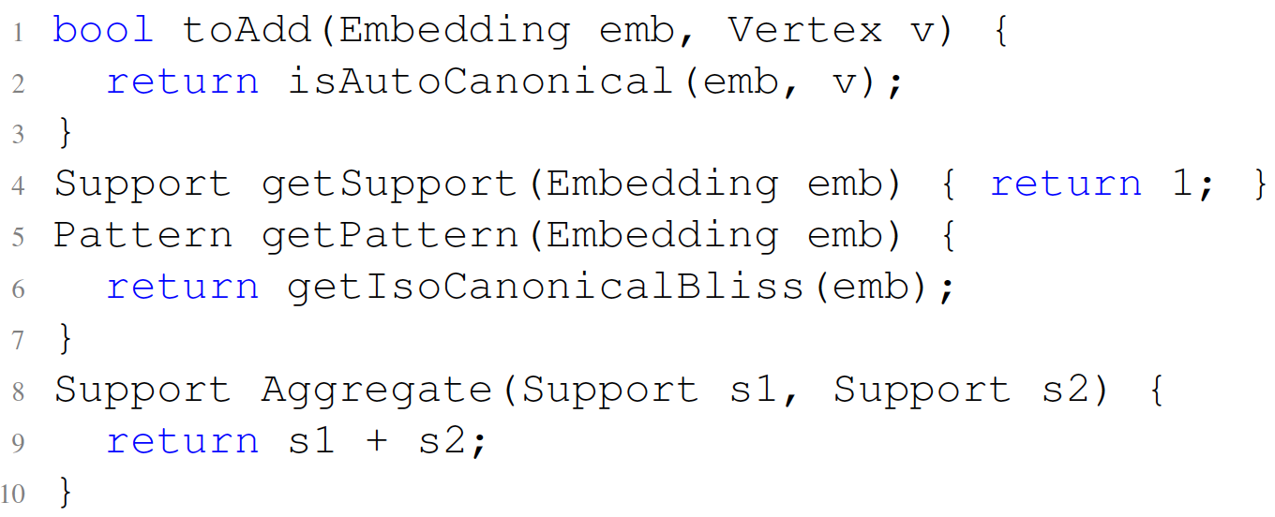
Composing Applications using Pangolin API
Motif counting
State-of-the-art
(PGD: ICDM’15)
2,538 LOC
Notes:
Here is an example that shows how to implement motif counting in Pangolin framework.
(click) The programmer can use an API function called toAdd to apply the default automorphism check provided by the system.
Overall, this motif counting implementation is as simple as those in previous systems.
(click) In comparison, the state-of-the-art hand-written motif counting solver has more than 2000 lines of code.
Motifs are found simultaneously

Slide 12
Application-specific Optimizations
Search space pruning
Avoid unnecessary enumeration
Avoid graph isomorphism (GI) test
Replace GI tests with simple checks
Notes:
To achieve high performance, the Pangolin programming interface exposes some details of the mining process,
And therefore the user can apply search space pruning to avoid unnecessary enumeration
and replace expensive graph isomorphism test with simple checking logic.

Slide 13
Search Space Pruning
Level 1
Level 2
Level 3
Notes:
Here is an example of pruning.
In this example, suppose we want to find a pattern of 4-clique,
(click) at the third level, we only need to extend the triangle.
There is no need to extend the other two embeddings, because they are definitely not going to be a 4-clique.
Given a specific pattern, an efficient mining solver will try to only enumerate necessary intermediate embeddings to reduce the search space.
As we mentioned before, automorphism check is used to remove redundant embeddings, this is one way to prune the search space.

Slide 14
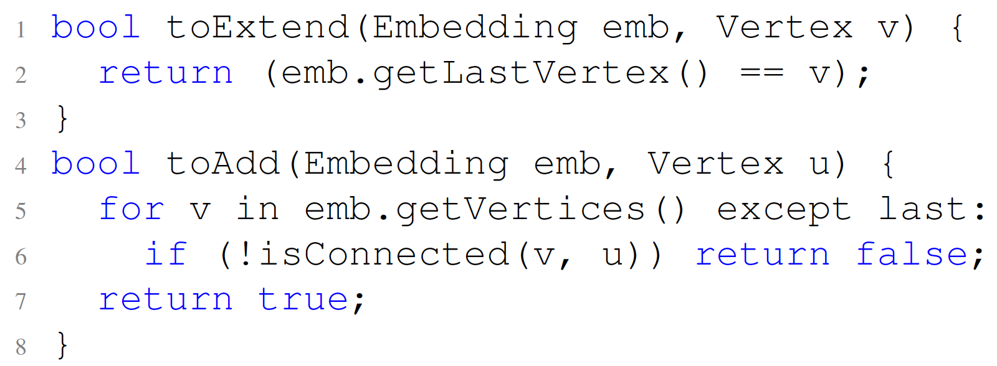
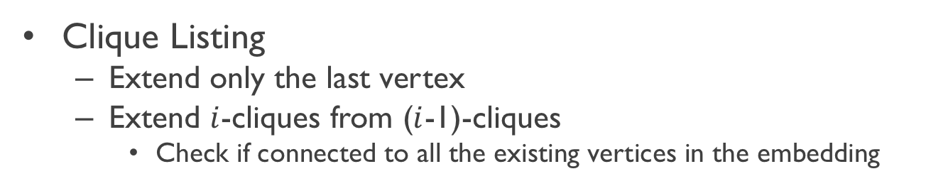
Pruning Search Space
Clique Listing
Extend only the last vertex
Extend $i$-cliques from ($i$-1)-cliques
Check if connected to all the existing vertices in the embedding
State-of-the-art
(KClist: WWW’18)
395 LOC
Notes:
This is the Pangolin user code for k-clique listing.
To implement the pruning in Pangolin, we need only to implement two API functions
(click) toExtend and (click) toAdd.
toExtend …
toAdd …
(click) In comparison the hand-written k-clique listing solver has almost 400 lines of code.
Note that previous systems do not expose the ‘toExtend’ API function, and therefore their users can not implement this optimization of pruning.

Slide 15
Evaluation
CPU platform:
Intel Xeon Gold 5120 CPU 2.2GHz, 2 sockets (14 cores each), 28-thread; 190GB memory, and 3TB SSD;
GPU platform:
NVIDIA Tesla V100 GPU (32G HBM2) and
NVIDIA GTX 1080Ti GPU (11G GDDR5X).
GPM Applications:
TC Triangle Counting
CL Clique Listing
MC Motif Counting
FSM Frequent Subgraph Mining
Dataset | Abbr. | |V| | |E| | Labels
MiCo | Mi | 100K | 2M | 29
Patent | Pa | 2.7M | 28M | 37
Youtube | Yo | 7M | 114M | 29
ProteinDB | Pdb | 48M | 387M | 25
Dataset | Abbr. | |V| | |E| | Labels
LiveJournal | Lj | 4.8M | 86M | 0
Orkut | Or | 3M | 234M | 0
Twitter | Tw | 21M | 530M | 0
Gsh-2015 | gsh | 988M | 51B | 0
Vertex-labeled Graphs
Unlabeled Graphs
Notes:
We evaluate Pangolin on CPU and GPU using 4 GPM applications.
(click) These are some of the labeled and unlabeled graphs we used in the experiments.
(click) We use patent dataset to show the results in this talk.
More results can be found in the paper.

Slide 16
Comparing with Existing Systems on CPU
Geomean speedup of 49x, 88x, 80x over Arabesque, RStream, Fractal
TC: Triangle Counting
CL: Clique Listing
MC: Motif Counting
FSM: Frequent Subgraph Mining
Intel Xeon Gold 5120 CPU 2.2GHz, 2 sockets (14 cores each), 190GB memory, and 3TB SSD
Input graph: Patent
Notes:
We compare the performance of Pangolin with previous GPM systems, Arabesque, RStream, and Fractal, all on the same CPU platform.
The figure shows the execution time in log-scale. Lower is better.
Due to the optimizations like search space pruning and avoiding isomorphism test,
As well as efficient parallel implementations,
Pangolin consistently outperforms existing systems.
(click) On average we observe 49, 88 and 80 times speedup over Arabesque, RStream, and Fractal.
For some applications, such as 3-motif counting, Pangolin is orders of magnitude faster.
(click) Pangolin even achieves competitive performance with hand-optimized implementations for many cases, significantly reducing the performance gap.

Slide 17
Pangolin: GPU Speedup over CPU
GPU platforms:
Tesla V100 GPU (32G HBM2)
GTX 1080Ti GPU (11G GDDR5X).
Geomean speedup of 15x on V100 over multi-core CPU
Speedup of Pangolin on GPU over Pangolin on 28-thread CPU*
TC: Triangle Counting
CL: Clique Listing
MC: Motif Counting
FSM: Frequent Subgraph Mining
Input graph: Patent
Notes:
Pangolin also supports GPU mining. Thanks to our efficient implementations for the GPU architecture,
(click) we can further speedup GPM applications by 15 times on the V100 GPU compared to multi-core CPU.

Slide 18
Conclusion
Pangolin: an efficient and flexible GPM system
Simple & flexible API to enable application specific optimizations
Efficient parallel implementation to exploit underlying hardware
Compared to hand-optimized implementations: less programming effort
Compared to existing GPM systems: orders of magnitude faster
Notes:
To conclude, Pangolin is an efficient and flexible GPM system,
(click) it provides simple and flexible API to enable application specific optimizations.
(click) It is efficiently implemented to exploit modern parallel hardware.
(click) Compared to hand-optimized implementations, pangolin provides much better programming experience;
(click) Compared to existing GPM systems, it is orders of magnitude faster.

Slide 19
Thank You!
Code release: https://github.com/IntelligentSoftwareSystems/Galois/tree/master/lonestar/mining
Xuhao Chen
Roshan Dathathri
Gurbinder Gill
Keshav Pingali

Slide 20
GPU Speedup
* Missing bars indicate out of memory

Slide 21
Programming Complexity (Lines-of-code)
 | TC | CL | MC | FSM
Hand-written (C/C++) | (GAP) 89 | (KClist) 394 | (PGD) 2,538 | (DistGraph) 17,459
Pangolin (C++) | 26 | 36 | 82 | 252

Slide 22
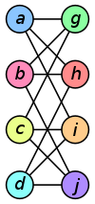
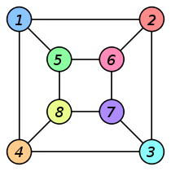
Avoiding GI Test
Graph isomorphism (GI) test is expensive
GI test is not always necessary
?
Simple checking
for 3-motif counting
GI test for an arbitrary pattern
slow
fast

Slide 23
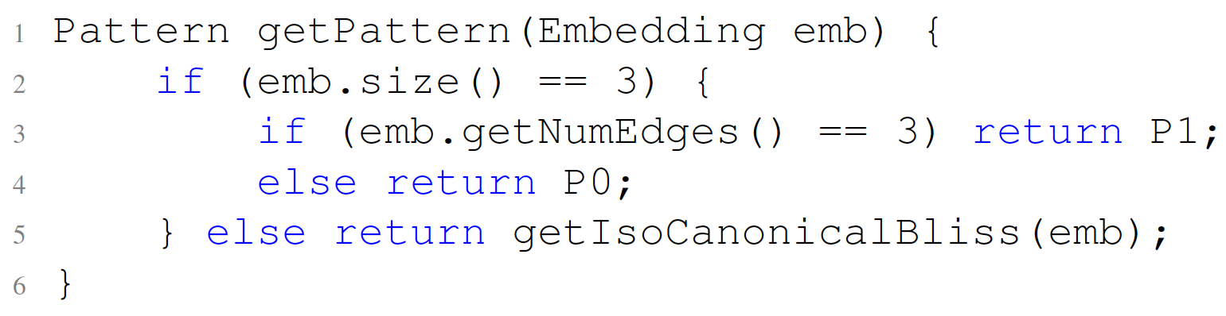
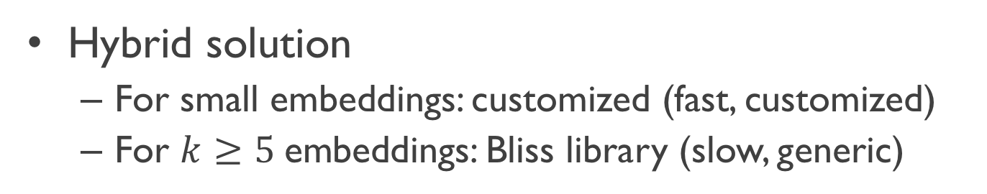
Avoiding GI Test
Hybrid solution
For small embeddings: customized (fast, customized)
For $k≥5$embeddings: Bliss library (slow, generic)
P0: wedge
P1: triangle
Notes:
For $k<9$ embeddings: eigenvalue based isomorphism test (fast)

Slide 24
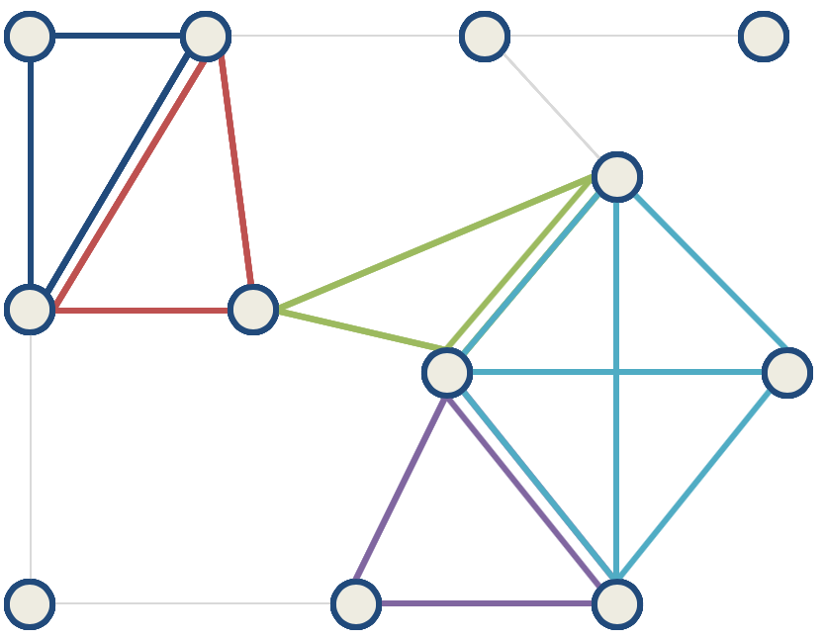
Graph Analytics vs. Graph Mining
Graph Analytics
Graph Mining
Computes properties of
the underlying graph
Discovers structural patterns
in the underlying graph
Community
Detection
PageRank
Motif counting
Clique Listing

Slide 25
Embedding List Data Structure (AoS)
Level 1
Level 2
Level-1: 2-vertex embeddings
[{0, 1}, {0, 2}, {1, 2}, {1, 3}, {2, 3}]
Level-2: 3-vertex embeddings
[{0,1,2}, {0,1,3}, {0,2,3}, {1,2,3}]

Slide 26
Embedding List Data Structure (SoA)
t₀
t₁
t₂

Slide 27
Embedding List Data Structure (SoA)
Better temporal locality
High-degree vertices are reused
Better spatial locality for GPU computing
Coalesced memory accesses

